Slide 1
Parallelization of K-Means Clustering Algorithm
Gopinath Dayalan
COMP 605 Scientific Computing

Slide 2
Contents
Introduction
K-Means
Goal
Algorithm
Evaluation
Result
Inference
Future Scope

Slide 3
Clustering
Clustering refers to grouping data points together based on some similarities.
K-Means
Mean-Shift
DBSCAN
EM
Hierarchical

Slide 4
K-Means
Unsupervised machine learning algorithm
Divides the dataset into k clusters
Based on distance of each datapoint from the centroid

Slide 5

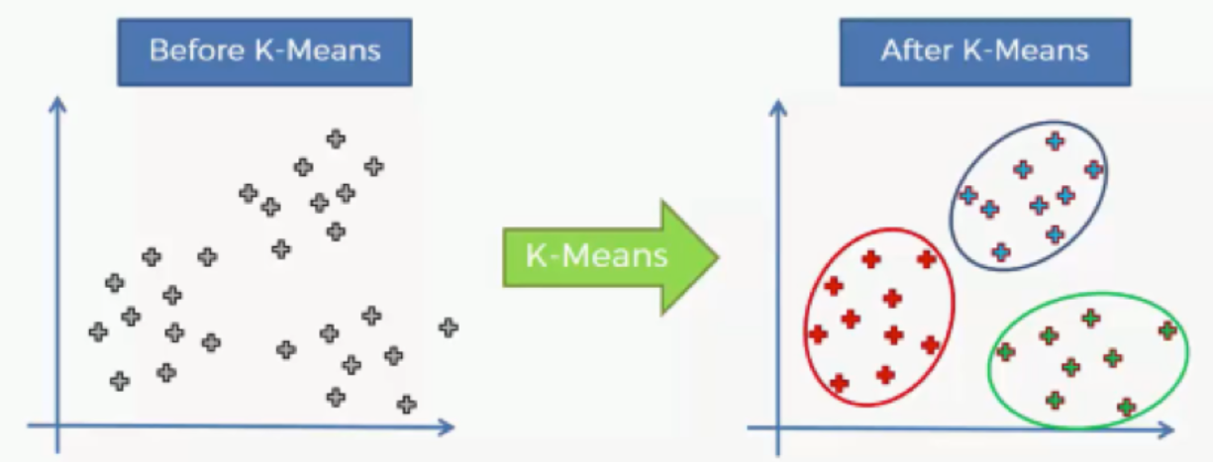
I/O
Input
K value
Approach 1: Assign value for K
Approach 2: Choose a range
Dataset for clustering
Credit Card Transaction
Output
Centroid of K clusters
SSE for each cluster
K subsets of dataset and their respective centroid

Slide 6
How it works? – Sequential Algorithm
Get K & Dataset
Randomly select k samples or datapoints from the given dataset
For each point, find the centroid closer and add to it
Calculate the centroid of the cluster
Repeat step 3,4,5 until the centroid remain constant
Compute SSE (Sum of Squared Errors)

Slide 7
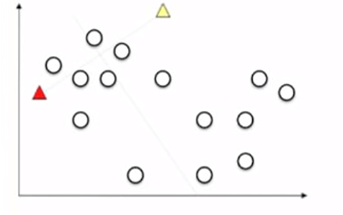
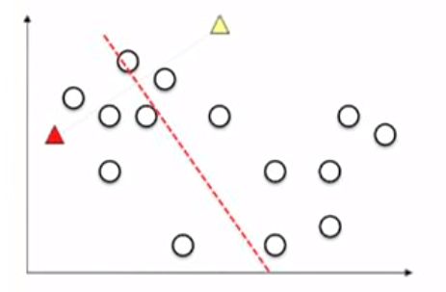
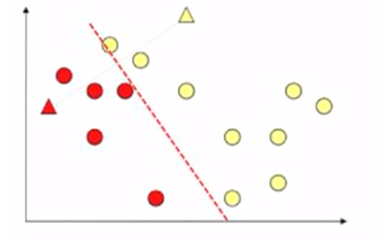
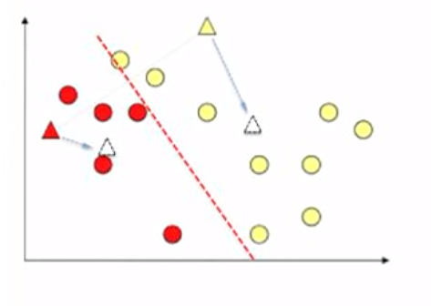
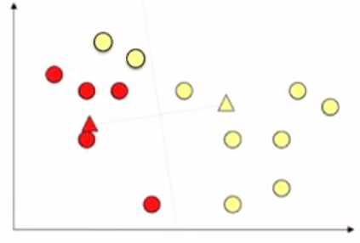
Example

Slide 8
Downside
Time complexity : O( n * K * I * d )
n = number of points ~ 10,000
K = number of clusters Lets say 10
I = number of iterations Assume its 10
d = number of attributes dimension = 12
Approx ~ 12 Million calculations

Slide 9

Goal
Parallelize
Datapoints to a centroids
SSE Computation
Using pthread & OpenMP

Slide 10
Parallel Algorithm
Node 0 randomly chooses k datapoints
Each thread is assigned with N/Threads datapoints
Thread calculates the membership for each point
Combine the result and calculate mean for each cluster
Stop when the diff(old centroid, new centroid) < threshold
Follow Similar step for SSE

Slide 11
Race Conditions
SSE calculation
Using mutex in pthread
Using reduction(+:sse) in OpenMP

Slide 12
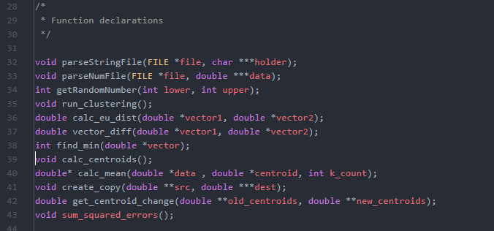
Code Snippet

Slide 13
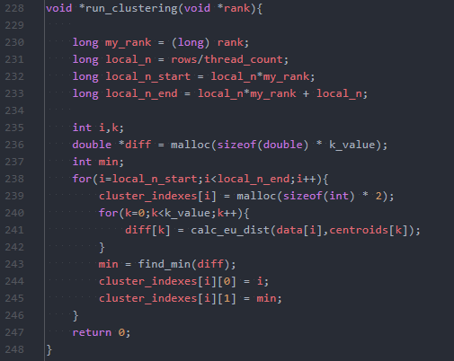
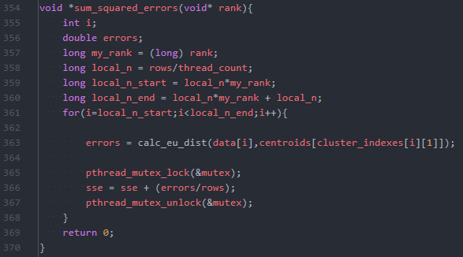
Code Snippet(P-thread)

Slide 14
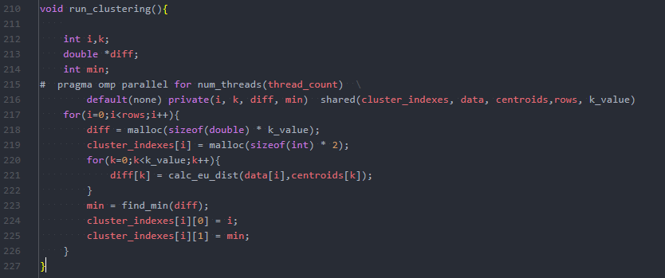
Code Snippet(OpenMP)

Slide 15
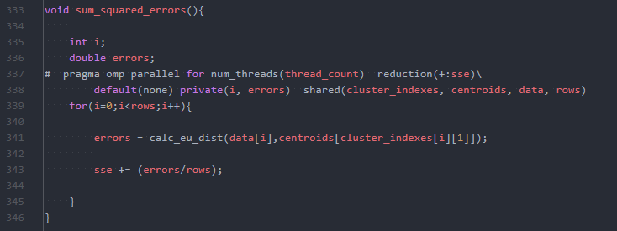
Code Snippet(OpenMP)

Slide 16
Evaluation
Datapoints of 1000x12, 10000x12, 100000x12
Execute with serial code
Execute with pthread (thread 2, 4, 8 & 10)
Execute with OpenMP (thread 2,4, 8 & 10)
Compare the results

Slide 17
Evaluation
Time calculation:
From clustering to SSE for K range
Data load time ignored

Slide 18
Approach 2: Choose the range

Slide 19
Result : Serial Code
 |  | (in seconds)
No. of Datapoints | 1000 | 0.358343
 | 10000 | 6.105595
 | 100000 | 47.315090

Slide 20
Result : P-thread
 |  | No. of Threads
 |  | 2 | 4 | 8 | 10
No. of Datapoints | 1000 | 0.362271 | 0.235984 | 0.217588 | 0.214803
 | 10000 | 5.302395 | 3.935083 | 3.267711 | 2.857791
 | 100000 | 22.797150 | 16.971880 | 11.994180 | 11.788930

Slide 21
Result : OpenMP
 |  | No. of Threads
 |  | 2 | 4 | 8 | 10
No. of Datapoints | 1000 | 0.231435 | 0.189158 | 0.184874 | 0.173551
 | 10000 | 1.930362 | 1.569147 | 1.667151 | 1.646268
 | 100000 | 21.277540 | 15.975370 | 15.947590 | 16.425690

Slide 22
Result : Serial vs Parallel

Slide 23
Result : P-thread vs OpenMP

Slide 24
Result & Inference
Parallel Algorithm always better than serial
Time increases as k increases
Results are average of 5 rounds
Performance of OpenMP is better when dataset and thread count is low
Performance of P-thread is better when dataset and thread count is high
Resultant centroid might differ at every instance, since they are initialized randomly

Slide 25
Future Scope
Better approach to initialize the values
Implement using CUDA

Slide 26
Thank You!

